Slide 1
JAVA BASIC
THE PROJECT

Slide 2
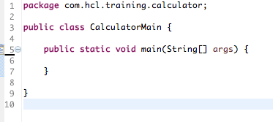
Create a New (Calculator) project (You can use the same Workspace)
Create a Package com.hcl.training.calculator
Create a Class CalculatorMain
Create a main method.

Slide 3
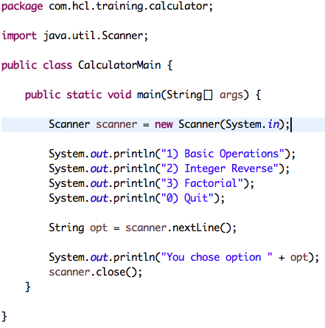
Review Previous Session
Key Concepts:
Import
Quick Review
package
class
access modifiers
Overview Scanner Class

Slide 4
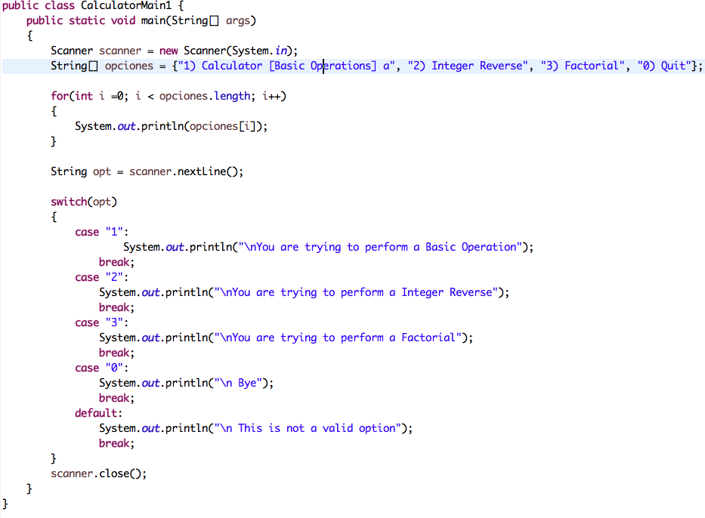
Key Concepts:
Control Flow Structures
for
switch/case
break

Slide 5
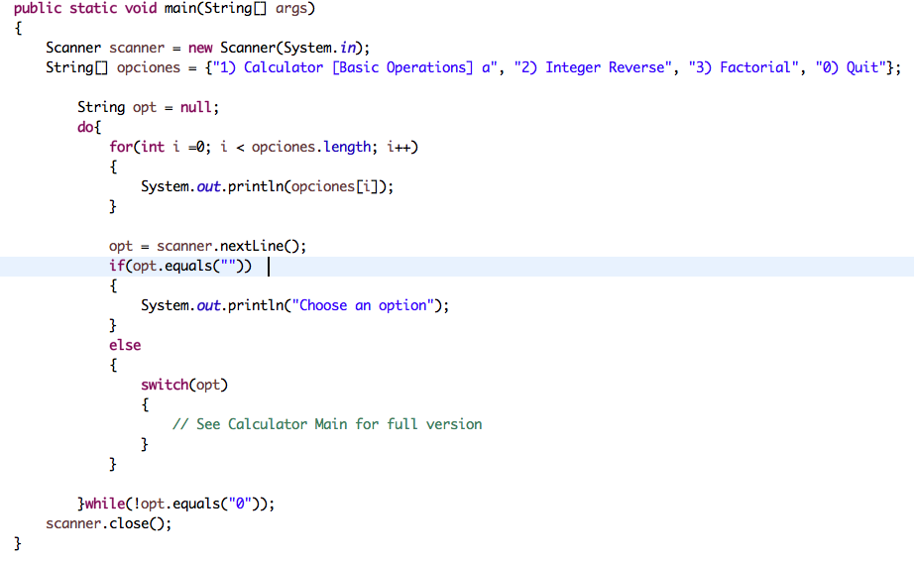
Key Concepts:
Control Flow Structures
if/else
do/while
difference between while and do/while

Slide 6
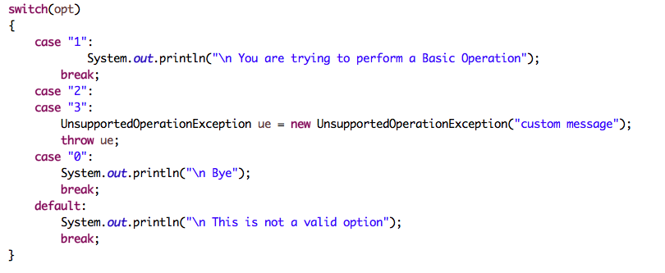
Overview Exceptions
Key Concepts:
Overview of Exceptions
throw
Runtime Exception
Compile Time Exceptions

Slide 7
¿Preguntas?

